Slide 1
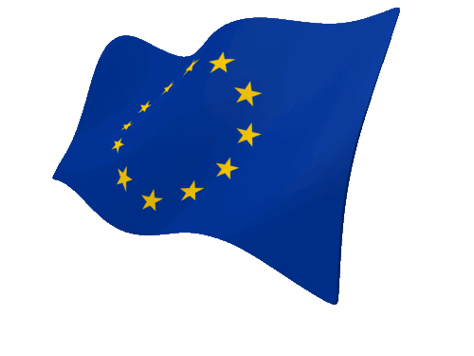
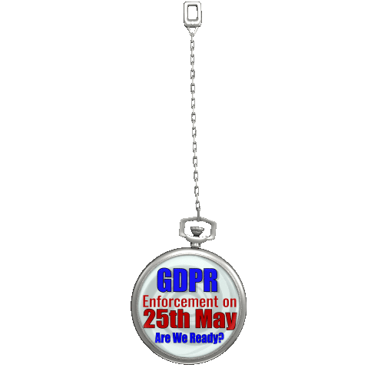

How ServiceNow Can Help Your Compliance Journey to GDPR
Knowledge®18
Manoj Patel Security & Risk Global Practice EMEA ServiceNow

Slide 2


Speaker Introduction
Name: Manoj Patel
Title: Senior Advisory Solution Consultant
Function: Security & Risk Global Practice EMEA
Company: ServiceNow
Manoj Patel, serves as Senior Advisory Solution Consultant for ServiceNow’s Global Security and Risk BU, focused on solving Enterprise Risk & Cyber Security challenges. He brings a total of 20+ years of experience in Enterprise Service & Legal Management, Governance, Risk & Compliance & Security space.
He is a regular guest speaker at ISACA EuroCACS, ISACA CSX and Gartner conferences for GRC, GDPR & CyberSecurity topics. His blog posts on GDPR & Cyber Security can be found on LinkedIn. He holds an MBA (Finance) from UK, M.S (Computer Science) from Germany, and B.Sc. (Physics) from India. He is certified as GRCP (OCEG) and in CyberSecurity (CSX).
Hobbies: Paintings, Golf, Cooking, Jazz & Cycling.
He is certified GRCP (OCEG) and CSX CyberSecurity (ISACA). He holds an MBA (Finance) from UK, M.S. (Computer Science) from Germany, and B.Sc. (Physics) from India.
Notes:
Note: Speaker Introduction slide – option 1. Please use one slide per presenter.

Slide 3
Speaker Introduction
Name:
Title: Senior Advisory Solution Consultant
Function: Security & Risk Global Practice EMEA
Company: ServiceNow
Notes:
Note: Speaker Introduction slide – option 1. Please use one slide per presenter.

Slide 4
Agenda
Deciphering the GDPR
How ServiceNow can Help
Questions?

Slide 5
GDPR Part I GDPR context, requirements & challenges

Slide 6
GDPR By The Numbers
2018
25th of May, 2018 the regulation will be enforced
4%
Potential fines as a percentage of global turnover
7
Core individual rights afforded under the GDPR
72
Hours given to report a data breach
250m
Cost of 4% fine for a typical FTSE 100 company
128,000
DPOs required in the EU
190+
Countries potentially in scope of the regulation
80+
New requirements in the GDPR
Notes:
Just to take a minute here and give you some brief highlights about what GDPR is. GDPR stands for General Data Protection Regulation. It’s a new regulation voted last May 2016 in the European Union. But it doesn’t only apply to the 28 European countries. It actually applies to all countries and all companies who are hosting EU citizen personal data. It can be customers, it can be staff, it can be 3rd parties, vendors. Any kind of contact you have and you record in your systems is a target, meaning that potentially all companies are targeted by this regulation and we have to show and demonstrate compliance – particularly highly international organizations have to comply to the GDPR. It is quite an expensive regulation in terms of finalities (?) as well. We talked about 4% of the global turnover of companies at stake. It is very demanding in terms of processes. We’ll do that in more detail in a minute, but just to illustrate one of those requirements, 72 hours to be able to report a personal data breach. Who companies are able to do that today, I’m not sure. Maybe those who have implemented Enterprise Security Response from ServiceNow have a better chance to get there on time, but it is a really challenging regulation. So let’s have a look deeper.

Slide 7

Regulations Driving IT Spend
The regulations that matter the most What regulations are driving the funding of your organization IT security?
EU General Data Protection Regulation
Internal laws by country
PCI DDS
Sarbanes-Oxley
US state laws for data breach
GLBA
HIPAA (including HITECH)
NERC CIP
FISMA
FACTA
FCRA
Federal Privacy Act
CANSPAM
Notes:
Companies everywhere must be prepared for GDPR and that is reflected in spend initiatives. We’ll take a closer look at why the focus remains centered on GDPR.

Slide 8
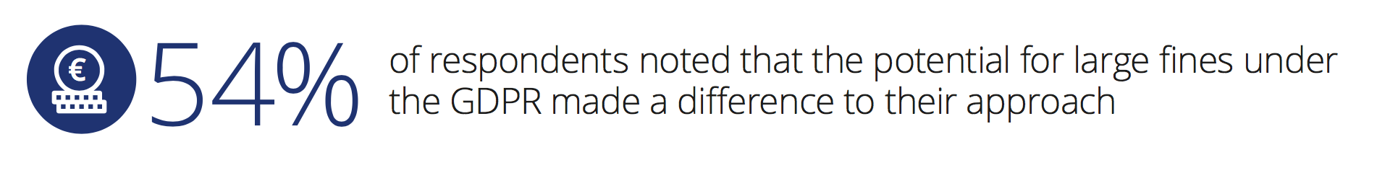
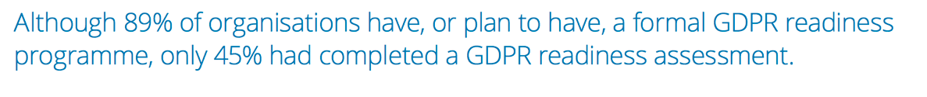
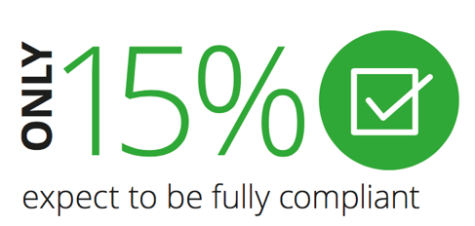
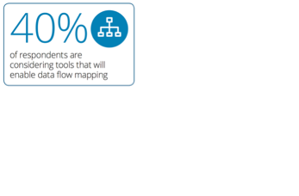

GDPR Stats*
*Source: Deloitte

Slide 9
GDPR Applicability for an Enterprise
Is the Enterprise in EU?
GDPR applies
YES
NO
Does Data Subject Reside or Stay in EU?
YES
NO
YES
YES
Is the Data Subject Currently being Transported EU?
Does the Processing relate to Offering Goods & Services?
Does the Processing relate to Monitoring the Behavior in EU?
YES
NO
NO
NO
GDPR doesn’t apply

Slide 10
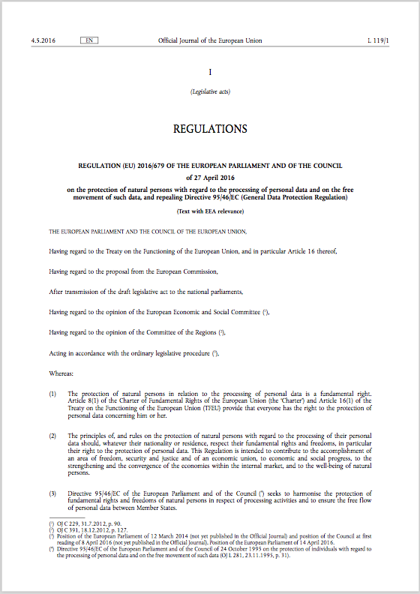

GDPR – What is it?
The General Data Protection Regulation (GDPR) (Regulation (EU) 2016/679) is a Regulation by which the European Commission intends to strengthen and unify data protection for individuals within the European Union (EU).
Major goals of the General Data Protection Regulation (GDPR) (2016/679/EU) are:
protection of EU citizens’ personal data
define the rules for a free movement of personal data in the EU
Enforcement date: 25 May 2018 - at which time those organisations in non-compliance will face heavy fines.

Slide 11
EU GDPR Personal Data - Definition
“Personal data is any information relating to an individual, whether it relates to his or her private, professional or public life. It can be anything from a name, a photo, an email address, bank details, posts on social networking websites, medical information, or a computer’s IP address."

Slide 12




Protect Personal Data?
Must have consent to use an EU citizen’s personal data
Must protect their privacy
Must be able to delete the personal data in all locations if the user requests it
“
Personal data is any information relating to an individual, whether it relates to his or her private, professional or public life. It can be anything from a name, a photo, an email address, bank details, posts on social networking websites, medical information, or a computer’s IP address.
IP: 123.54.789
”
Notes:
So what is personal data? Well, there’s a clear definition in the regulation, and a very very extensive one, actually. Because we talk here about any information related to individuals, whether private, professional, or public life. So name, photo (?), email address, of course bank, social security number, but as well social websites – I mean what you have published in Twitter or other social networks like Facebook, etc., medical information, your IP address, etc. All of that is considered personal data.

Slide 13

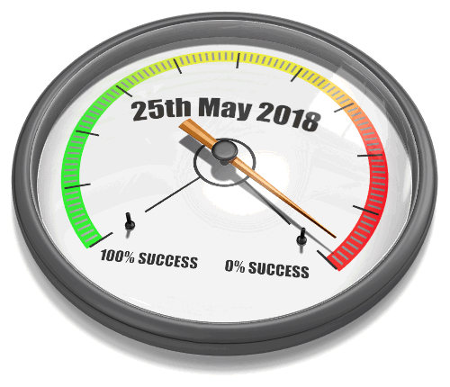
GDPR Amps Up the Challenges
Data Protection Impact Assessments (Article 35) have to be conducted when specific risks occur to the rights and freedoms of data subjects.
Risk assessment and mitigation is required and a prior approval of the DPA for high risks.
Enterprises that process personal data for 5,000 EU citizens or more must hire a Data Protection Officer.
Notes:
Now one of the specific requirements which is in article 35 of the regulation asks each company to run regularly a data protection impact assessment. It’s a very interesting process because it helps you to identify the gaps between where you are and what the regulation requests. So it’s generally where we start the journey with our customers. That’s the first step. We try to identify the size of the effort, the size of the journey to get to full compliance. But as well, the requirements asks you to run that regularly, not only at the beginning. So that again tracks regularly where you are in your journey, but as well, once you have compliance to continue to track if you keep compliant and if your situation doesn’t get worse after a few years.
And if you process the records of at least 5,000 EU citizens you must hire a Data Protection Officer. Adding together customers, employees, vendors, partners, prospects, and any other relevant category, you can get to 5,000 pretty quickly. This person is ultimately responsible for your company is compliant.

Slide 14
Top Takeaways
1
2
3
GDPR is a fact.
You have to align your data & processes with GDPR and there is not much time left to do so!
Familiarize with GDPR challenges & requirements while collecting and utilising EU citizen personal data.
Map those to your organizational policies & procedures.
Get professional guidance.
Implement GRC Best Practices.
If not started yet, you are already late
Notes:
Note: Please limit to one slide.

Slide 15
Top Takeaways
1
2
3
ServiceNow GRC is scalable to accommodate many new and existing regulations
The GDPR can be managed through ServiceNow’s GRC application and partner applications.
The heavily regulated industries can use the combination of GRC and SecOps for GDPR and much more
Notes:
Note: Please limit to one slide.

Slide 16
GDPR Part II How ServiceNow Can Help Your Compliance Journey to GDPR – A practical approach

Slide 17
How ServiceNow Can Help Your Compliance Journey to GDPR

Slide 18




Leverage the Now Platform to Implement GDPR
Governance, Risk, & Compliance (GRC)
Security Operations
Privacy Risk Framework
Policy &
Compliance
Management
Risk
Management
Audit
Engagement
Vendor Risk
Management
Security Incident
Response
Vulnerability
Response
Threat
Intelligence
GDPR Regulation Requirements
Privacy Policy Management
Privacy Audit Management
3rd Party GDPR Compliance
Single Database
Data Protection Impact Assessment
Subscription & Notification
Predictive Analytics
Workflow
Service Catalog
Service Portal
Contextual Collaboration
Knowledge Base
Developer Tools
Multi-instance
Secure & Compliant
Scalable
Notes:
Let’s start with Security Incident Response.
We integrate with an organization’s existing security tools, like a firewall, endpoint security product or Security Information and Event Manager to collect and prioritize security incidents. This prioritization includes not just the severity of a particular security issue, but due to ServiceNow’s deep integration with IT, we can factor in the type of asset or system or service affected which allows us to prioritize security incidents based on the actual impact the issue can have on your organization. We leverage ServiceNow’s core workflow, automation and orchestration capabilities to create purpose-built security workflows, automation and orchestrations to dramatically improve and manage the response process, including working with IT when needed.
<click> The second module within Security Operations is our Vulnerability Response application. If we think of Security Incident Response as being how we react to security incidents. Vulnerability Response is the opportunity to be proactive in reducing the attack surface by plugging the most important vulnerabilities.
We work with vulnerability assessment solutions, including leaders such as Qualys, Rapid 7 and Tenable, to take the results of their vulnerability assessments and help an organization manage the response process. And just like with the Security Incident Response module, we can marry the severity of the vulnerability with the rich IT information to understand the type of system that is vulnerable, allowing an organization to quick respond to their most business critical vulnerable items first. And we leverage ServiceNow’s workflow, automation and orchestration capabilities to make this happen fast.
<click>
And we have a threat intelligence application which really enhances all of the information in our Security Incident Response and Vulnerability Response applications.
We support STIX and TAXII allow an organization to work with nearly any threat intelligence feed – whether its an open source feed, a commercially available threat intelligence source or one of the sharing communities like an ISAC. We can pull relevant threat intelligence information directly into Security Operations so all of the information to make decisions is right there for a security analyst. This is a great area for automation. We can save that analyst tons of time by doing the manual, mundane lookups for them, allowing them to spend more time understanding the depth of the problem.
<click>
And most importantly, this is built on the ServiceNow platform. This is the same, proven Workflow that powers thousands of IT departments today – except they are built for security teams. And they can be used to pass tasks back and forth to get security problems solved.
The automation and orchestration capabilities on the ServiceNow platform are important to Security Operations as well. We’ve built orchestration packs to automate many of the manual, repeat processes that security teams do today such as automatically querying Palo Alto Networks Widlfire and Autofocus to enrich security incidents or leveraging Tanium to automatically query a potentially affected endpoint.
And most importantly, a deep integration with IT. This allows ServiceNow to first – understand what the an affected asset is. We know who owns it, what it does and how important it is – and this can be used to make a decision on how quickly to work on a problem – typically based on business impact. It is also important because most of the time, solving a security problems involves someone in IT. A task can be passed from a security person to an IT person in the same system – making for significantly more efficient security response.

Slide 19
Leverage the Now Platform to Implement GDPR
Governance, Risk, & Compliance (GRC)
Security Operations
Policy &
Compliance
Management
Risk
Management
Audit
Engagement
Vendor Risk
Management
Security Incident
Response
Vulnerability
Response
Threat
Intelligence
72-Hour Breach Notification
Privacy Breach to Risks Relationship
Single Database
Workflow
Service Catalog
Service Portal
Subscription & Notification
Contextual Collaboration
Predictive Analytics
Knowledge Base
Developer Tools
Data Subject Portal & Right to be “forgotten”
(Customer Service Management
PII Data Mapping
DPO Dashboard
(Performance Analytics)
Multi-instance
Secure & Compliant
Scalable
Notes:
Let’s start with Security Incident Response.
We integrate with an organization’s existing security tools, like a firewall, endpoint security product or Security Information and Event Manager to collect and prioritize security incidents. This prioritization includes not just the severity of a particular security issue, but due to ServiceNow’s deep integration with IT, we can factor in the type of asset or system or service affected which allows us to prioritize security incidents based on the actual impact the issue can have on your organization. We leverage ServiceNow’s core workflow, automation and orchestration capabilities to create purpose-built security workflows, automation and orchestrations to dramatically improve and manage the response process, including working with IT when needed.
<click> The second module within Security Operations is our Vulnerability Response application. If we think of Security Incident Response as being how we react to security incidents. Vulnerability Response is the opportunity to be proactive in reducing the attack surface by plugging the most important vulnerabilities.
We work with vulnerability assessment solutions, including leaders such as Qualys, Rapid 7 and Tenable, to take the results of their vulnerability assessments and help an organization manage the response process. And just like with the Security Incident Response module, we can marry the severity of the vulnerability with the rich IT information to understand the type of system that is vulnerable, allowing an organization to quick respond to their most business critical vulnerable items first. And we leverage ServiceNow’s workflow, automation and orchestration capabilities to make this happen fast.
<click>
And we have a threat intelligence application which really enhances all of the information in our Security Incident Response and Vulnerability Response applications.
We support STIX and TAXII allow an organization to work with nearly any threat intelligence feed – whether its an open source feed, a commercially available threat intelligence source or one of the sharing communities like an ISAC. We can pull relevant threat intelligence information directly into Security Operations so all of the information to make decisions is right there for a security analyst. This is a great area for automation. We can save that analyst tons of time by doing the manual, mundane lookups for them, allowing them to spend more time understanding the depth of the problem.
<click>
And most importantly, this is built on the ServiceNow platform. This is the same, proven Workflow that powers thousands of IT departments today – except they are built for security teams. And they can be used to pass tasks back and forth to get security problems solved.
The automation and orchestration capabilities on the ServiceNow platform are important to Security Operations as well. We’ve built orchestration packs to automate many of the manual, repeat processes that security teams do today such as automatically querying Palo Alto Networks Widlfire and Autofocus to enrich security incidents or leveraging Tanium to automatically query a potentially affected endpoint.
The most importantly, a deep integration with IT. This allows ServiceNow to first – understand what the an affected asset is. We know who owns it, what it does and how important it is – and this can be used to make a decision on how quickly to work on a problem – typically based on business impact. It is also important because most of the time, solving a security problems involves someone in IT. A task can be passed from a security person to an IT person in the same system – making for significantly more efficient security response.

Slide 20
9 Ways ServiceNow can Help
Map the identified GDPR requirements directly into the application, with underlying citation and controls needed for compliance checks and continuous monitoring. Then manage the policies through their full lifecycle.
PII Data Mapping
Data Protection Impact Assessments
GDPR Requirements & Description
Privacy Policy Management
Identify personal data using the ServiceNow CMDB to manage information assets, associate them to other Configuration Items, and generate risks and controls.
Align data protection assessments with data protection policies and underlying requirements to assess the risk to data subjects of processing operations.
Privacy Risk Requirements
Privacy Audit Management
Data Subject Portal
Get visibility into risk identification and compliance statistics, with notifications (including the associated risks) sent automatically to an SA at the time of breach. Controls and capabilities also address confidentiality, integrity, and availability of systems and applications.
Schedule regulator GDPR audits targeting the organization and its personal data sensitive systems, then generate remediation plans and track them to conclusion. Dashboards provide the ability to monitor the global level of compliance.
Use ServiceNow Customer Service Management and the Service Portal to share data (ex. policies, procedures) and collect decisions.
Notes:
PII Data Mapping - Identify personal data using the ServiceNow CMDB to manage information assets, associate them to other Configuration Items, and generate risks and controls.
GDPR Req & Description - Map the identified GDPR requirements directly into the application, with underlying citation and controls needed for compliance checks and continuous monitoring. Then manage the policies through their full lifecycle.
DPIA - Align data protection assessments with data protection policies and underlying requirements to assess the risk to data subjects of processing operations.
Risk Management - Get visibility into risk identification and compliance statistics, with notifications (including the associated risks) sent automatically to a Supervisory Authority (SA) at the time of breach. Controls and capabilities also address confidentiality, integrity, and availability of systems and applications.
Audit Management - Schedule regulator GDPR audits targeting the organization and its personal data sensitive systems, then generate remediation plans and track them to conclusion. Dashboards provide the ability to monitor the global level of compliance.
Data Subject Portal (CSM) - Use ServiceNow Customer Service Management and the Service Portal to share data (ex. policies, procedures) and collect decisions.

Slide 21
9 Ways ServiceNow can Help
3rd Party GDPR Compliance
72-Hour Breach Notification
&
Privacy Breach to Risk Relationship
Data Protection Office Dashboard
Manage the vendor portfolio and schedule data privacy assessments based on tiers or risks. A Vendor Portal consolidates communication, manages assessments, and issues. Use the GRC portfolio to roll-up vendor risk to the enterprise.
Use Security Operation to detect breaches and align with GRC data protection risks. Automatically generate notification to Supervisory Authority (SA) and execute response; tracking compliance status.
Provide visibility to the Data Protection Officer to pinpoint the location of incidents, monitor risk scores, and business impact using Performance Analytics and the Service Portal.
Notes:
3rd Party Vendor Management - Manage the vendor portfolio and schedule data privacy assessments based on tiers or risks. A Vendor Portal consolidates communication, manages assessments, and issues. Use the GRC portfolio to roll-up vendor risk to the enterprise.
72-hour breach notification (SecOps SIR) - Use Security Operation to detect breaches and align with GRC data protection risks. Automatically generate notification to Supervisory Authority (SA) and execute response; tracking compliance status.
DPO Dashboard (Performance Analytics) - Provide visibility to the Data Protection Officer to pinpoint the location of incidents, monitor risk scores, and business impact using Performance Analytics and the Service Portal.

Slide 22

ServiceNow Empowers you to Address GDPR
1
Easily identifying a European’s personal data
2
Track Compliance
3
Manage Risk
4
Effectively Communicate
Notes:
ServiceNow empowers you to address GDPR by easily identifying a European’s personal data, tracking compliance, managing risk, and effectively communicating to ensure their data is protected.
Tracking compliance: Managing GDPR requirements (authority docs) and privacy policy, DPIA, GDPR Audit Management, and PII data mapping
Managing Risk: Privacy Risk Management, 72-breach notification (SecOps – SIR), and 3rd-party risk
Communicating effectively: Data subject portal (CSM), DPO dashboard (PA)

Slide 23
Questions? For GDPR videos and whitepapers visit: www.servicenow.com/grc

Slide 24
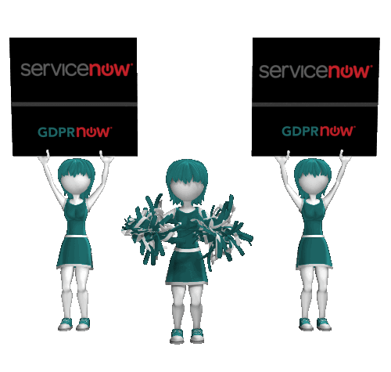
Manoj Patel | Security & Risk Global Practice EMEA
(GRCP (OCEG), MCIM, MBA, M.S. B.Sc.)
manoj.patel@servicenow.com
twitter: @Man0jPatel
Linkedin: https://de.linkedin.com/in/manojppatel
www.servicenow.com

